Slide 1



Kensri school -Stock ARena
Class 12 csc
Computer science project
Python and mysql connectivity
By – nishcit kumar
Tushar menon

Slide 2

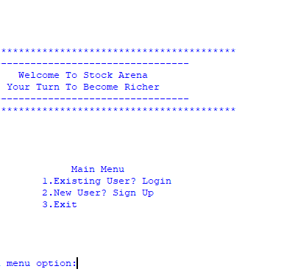
Menu
Existing User
New User
Exit

Slide 3

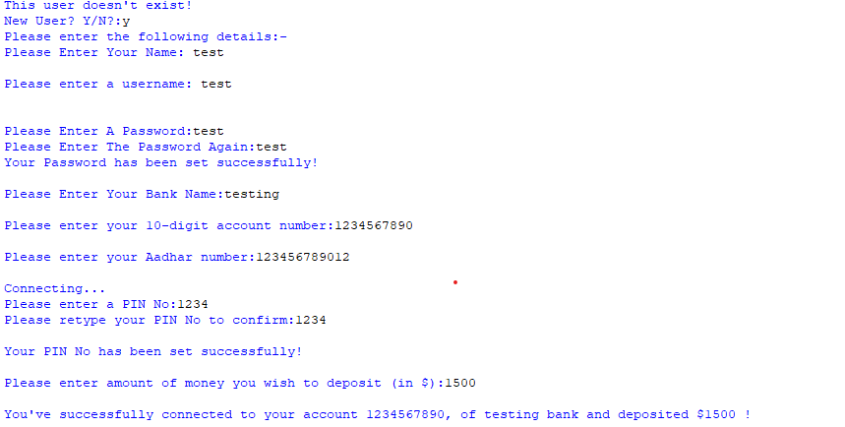
New user- DETAILS OF NEW USER IS ENTERD , ALSO ENTERING THE DEPOSIT MONEY

Slide 4
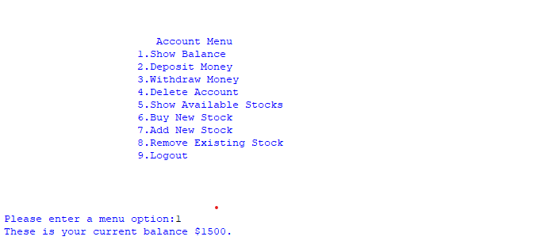
Show balance - this menu is shown when new user is entered on selecting option 1 we can see the balance

Slide 5
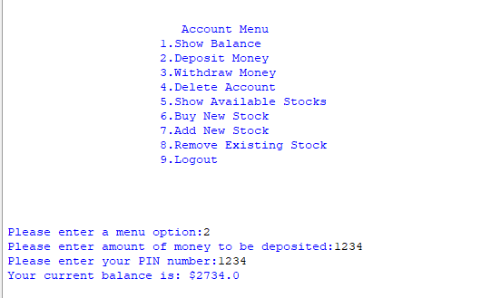
Deposite money - allows user to deposite money into their bank

Slide 6

Withdraw money allows user to withdraw money into their bank

Slide 7
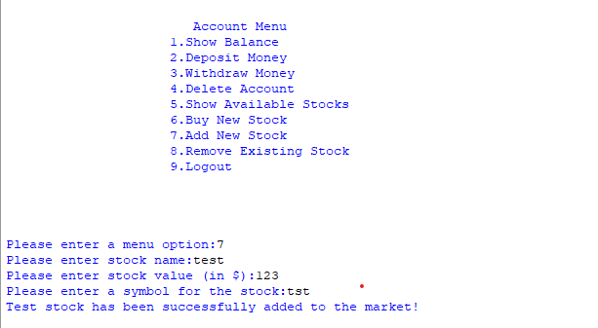
Add new stock- details of new stock entered

Slide 8
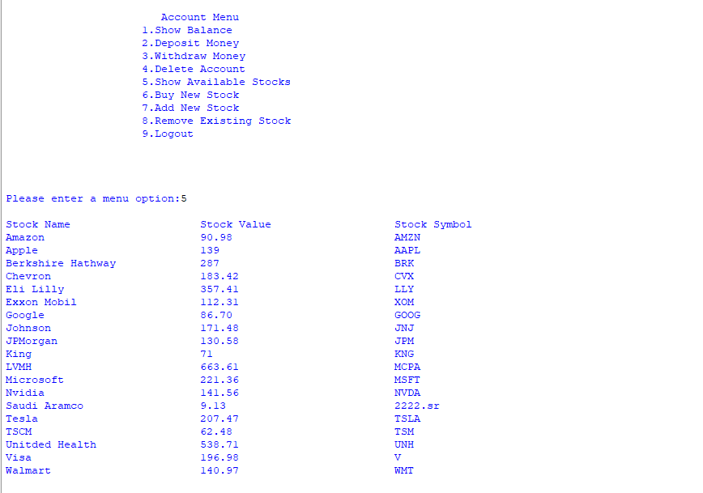
Display all stock displays stock info including recently entered stock

Slide 9
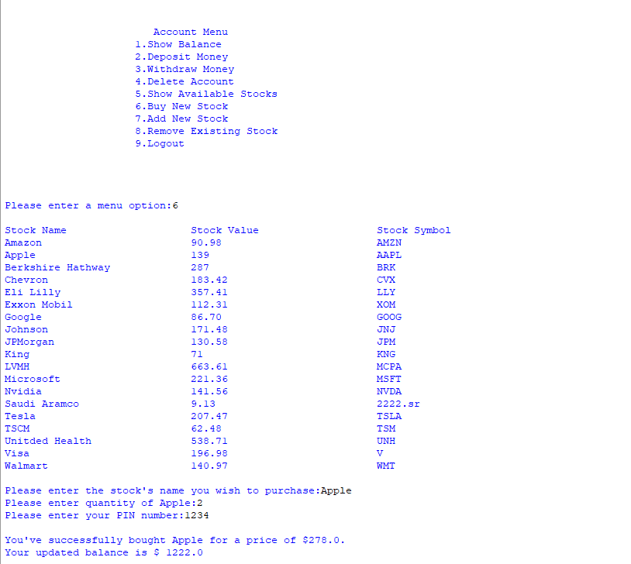
BUY stock Allows User to buy a stock and deducts money from their account

Slide 10
Add new stock Adds new stock which was previously not available

Slide 11
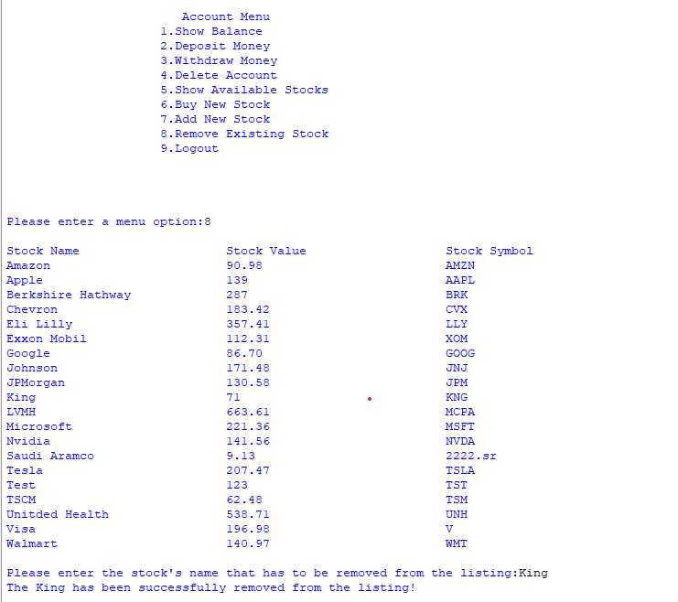
REmove stock REmoves selected stock

Slide 12
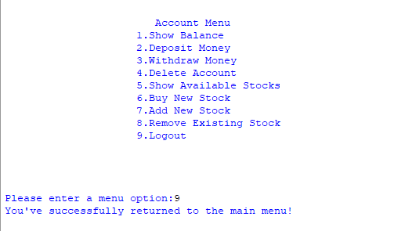
logout logs out user and returns to main menu

Slide 13


Thank you

